Slide 1
Smart Pot
Team members;
Arsal Abbasi
Charles Okere
Muhammad Umer Bin Yaqoob

Slide 2
Motivation
A lot of studies have been done on a wide range of subjects. Our topic requires us to conduct studies on a certain issue to and to acquire a generative notion about the automation intersection management which allows us to get interested in new ideas and approaches

Slide 3
Introduction
The number of people purchasing indoor plants is increasing daily
It can be challenging to maintain them
Germany imported 213.75 million indoor plants in bloom in 2021
Smart pot to measure temperature and humidity of the pot

Slide 4

Goals
Assist the people who like to have indoor plants
Integrating intelligent solutions
Providing the user acces to monitor plant‘s enviroment

Slide 5
MQTT
First version developed by Andy Stanford-Clark in 1999
Message queuing telemetry transport
Publish/subscribe messsaging protocol
Broker, Client, Topic, Publish/Subscribe
Clients connect to the network
Publish/Subcribe to to the

Slide 6
Concept Description
Smartpot that can measure temperature and humidity
The results will be displayed on android phone application and also raspberry pi which is acting as out mqtt broker
User will be able to change plants‘s location by sending one message from android phone to smartpot
The basic operating principle of this procedure depends on the data collected by DHT sensor inside the smart pot.

Slide 7
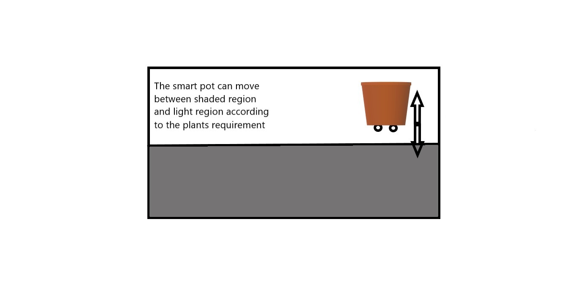

Slide 8
Hardware
Raspberry Pi – Broker
Arduino Uno wifi – Client
Android Phone – Client
DHT Sensor

Slide 9
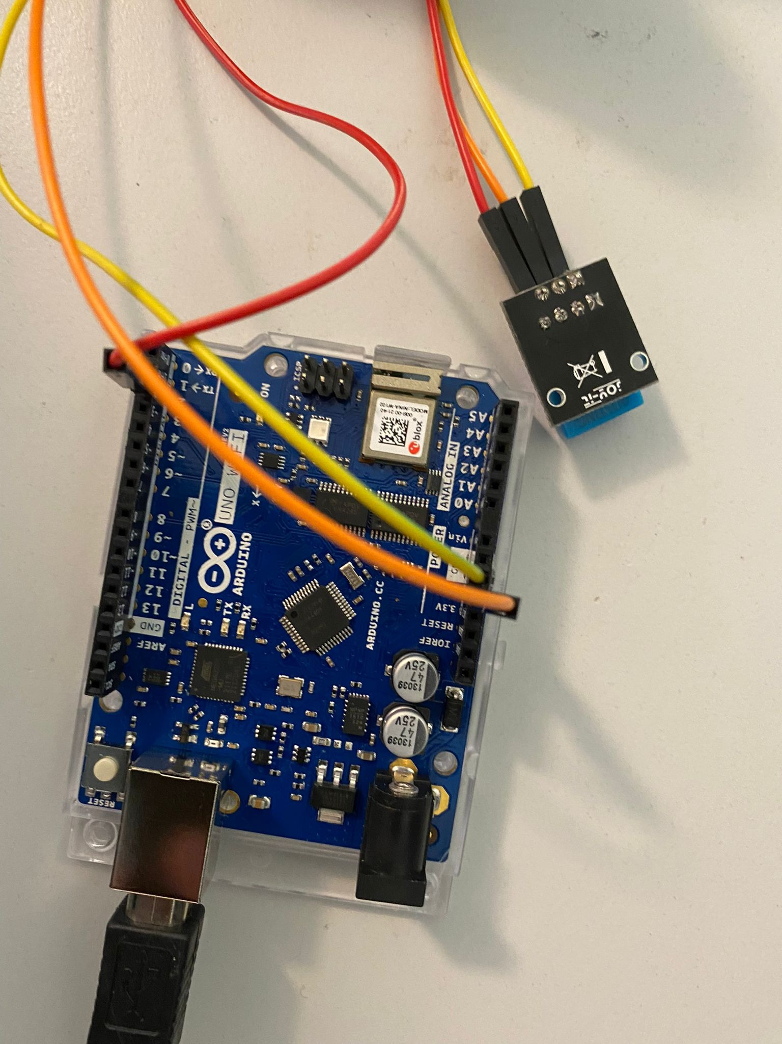
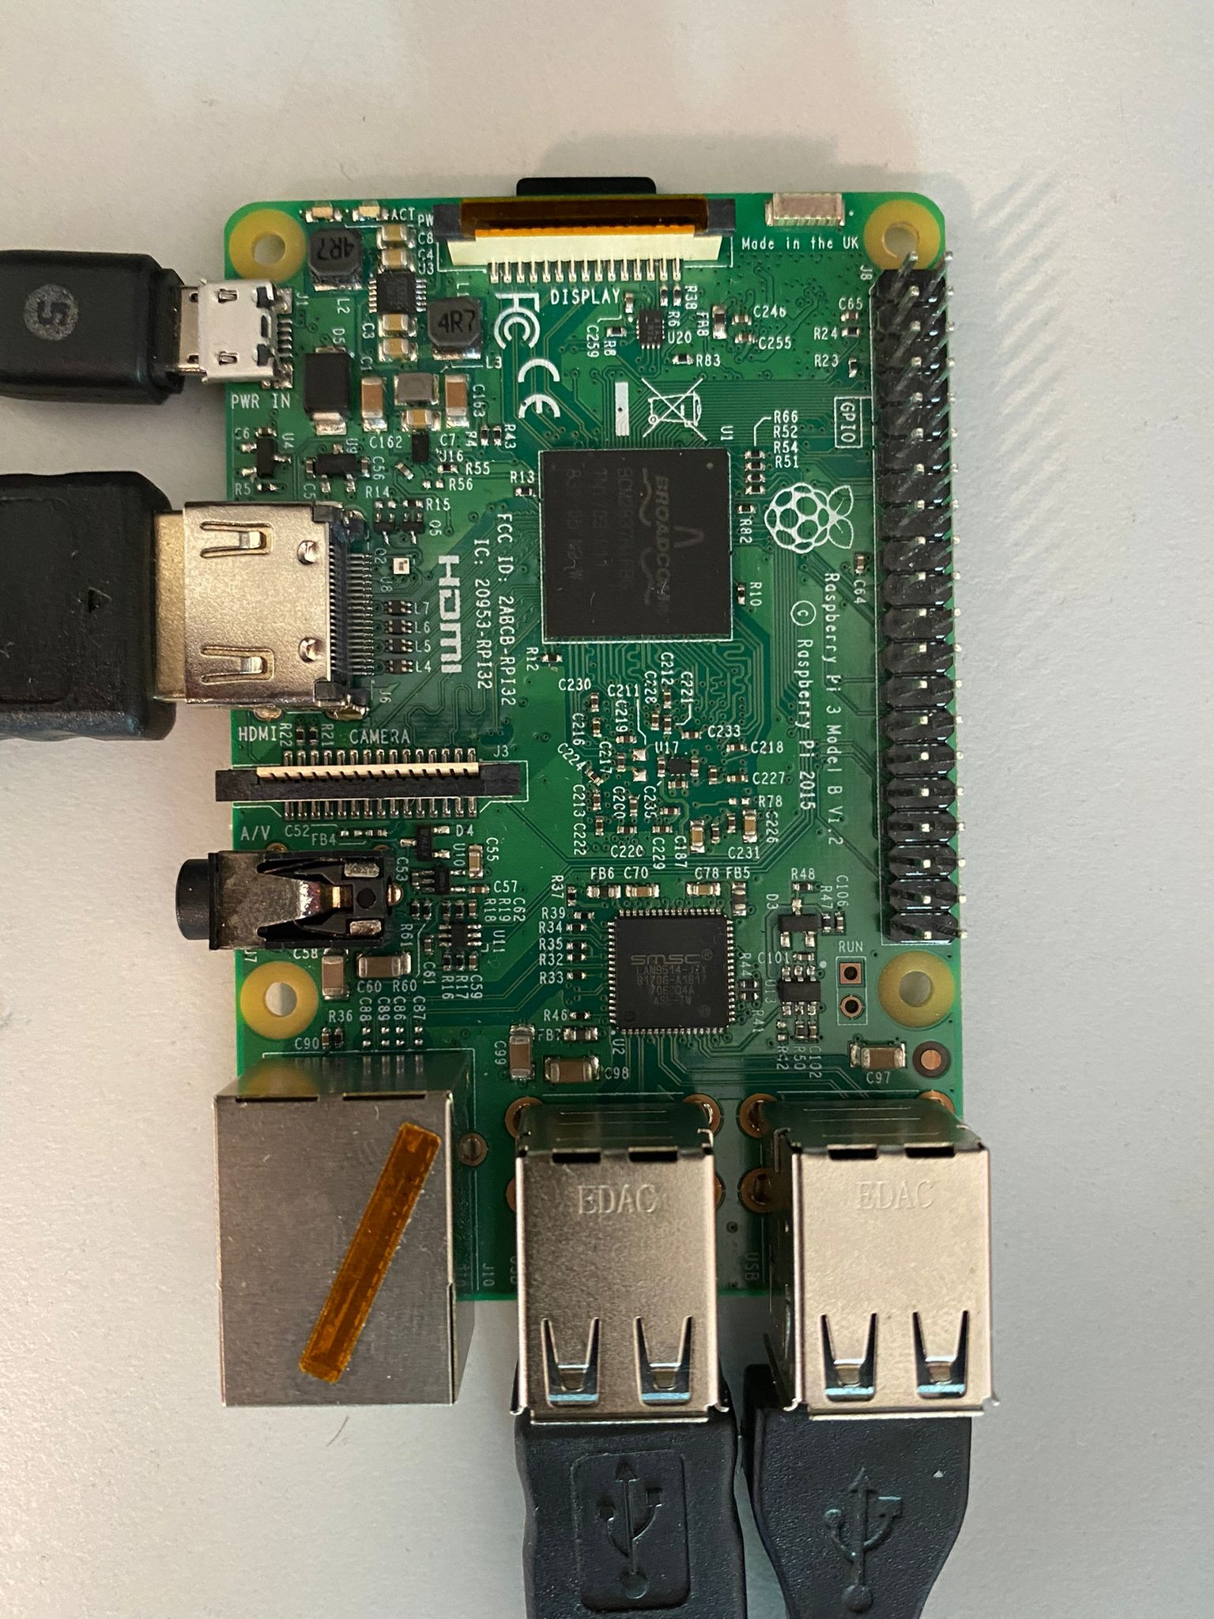
Fig. 1 DHT11 with Arduino uno wifi
Fig. 2 Raspberry pi

Slide 10
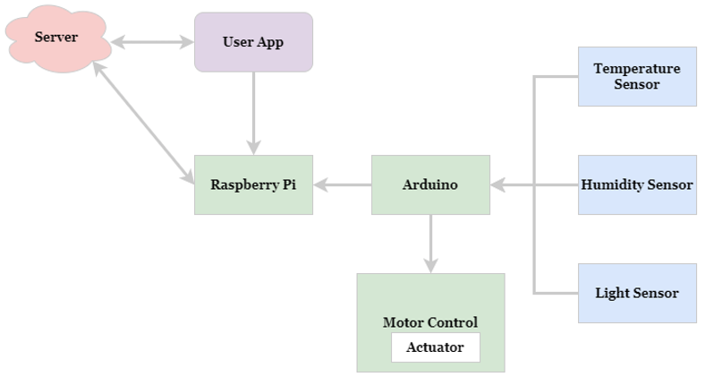
Block Diagram
Fig.3 Block Diagram

Slide 11
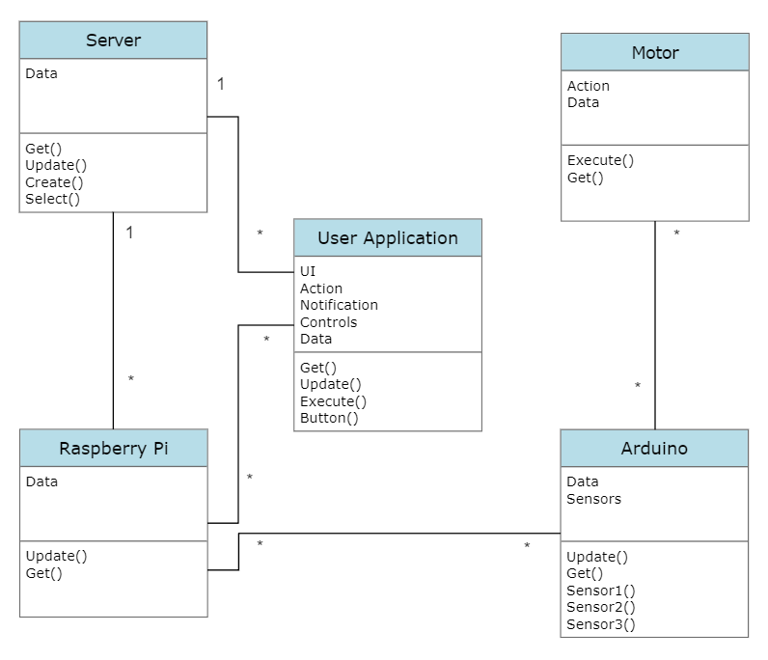
Class Diagram
Fig. 5 Class Diagram

Slide 12
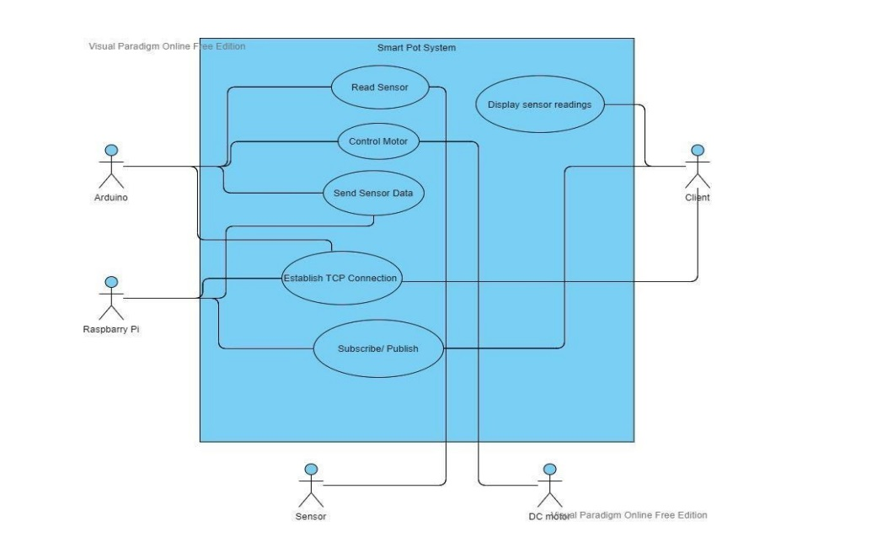
Use Case Diagram
Fig. 4 Use Case Diagram

Slide 13
Methodology
Double Diamond approach; Discover-Define-Develop and Deliver

Slide 14
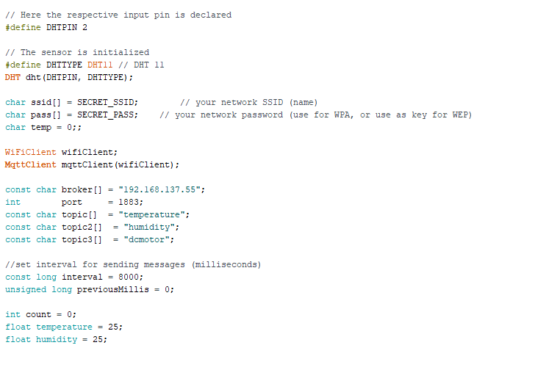
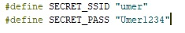
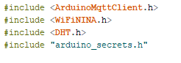
Code
Storing Wifi credentials
Libraries

Slide 15
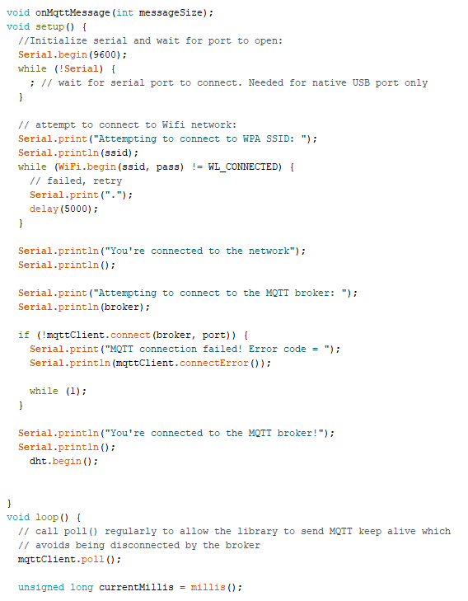
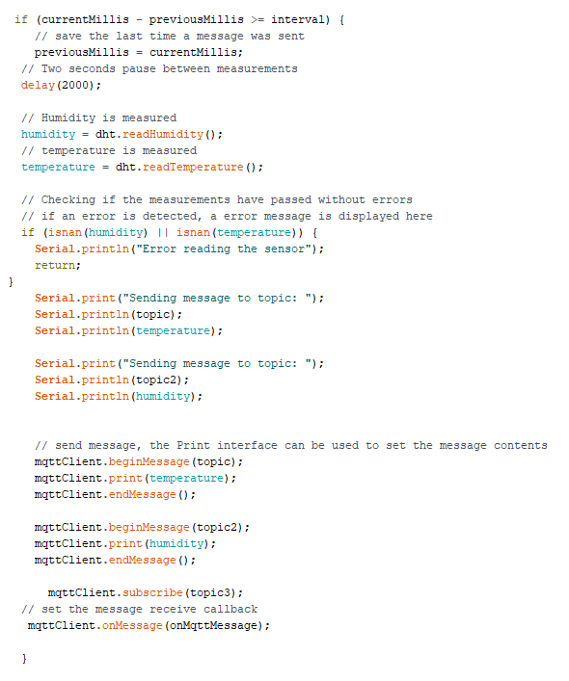

Slide 16
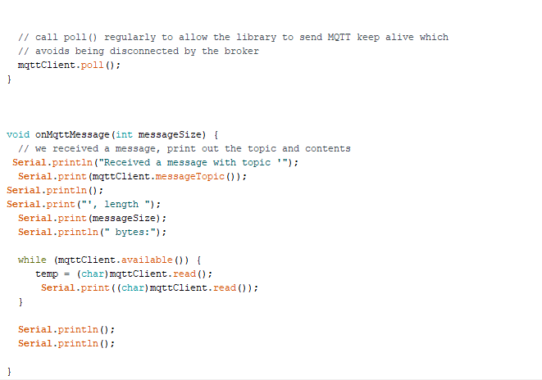

Slide 17
Implementation
https://youtu.be/VUJcxS1a9kw

Slide 18
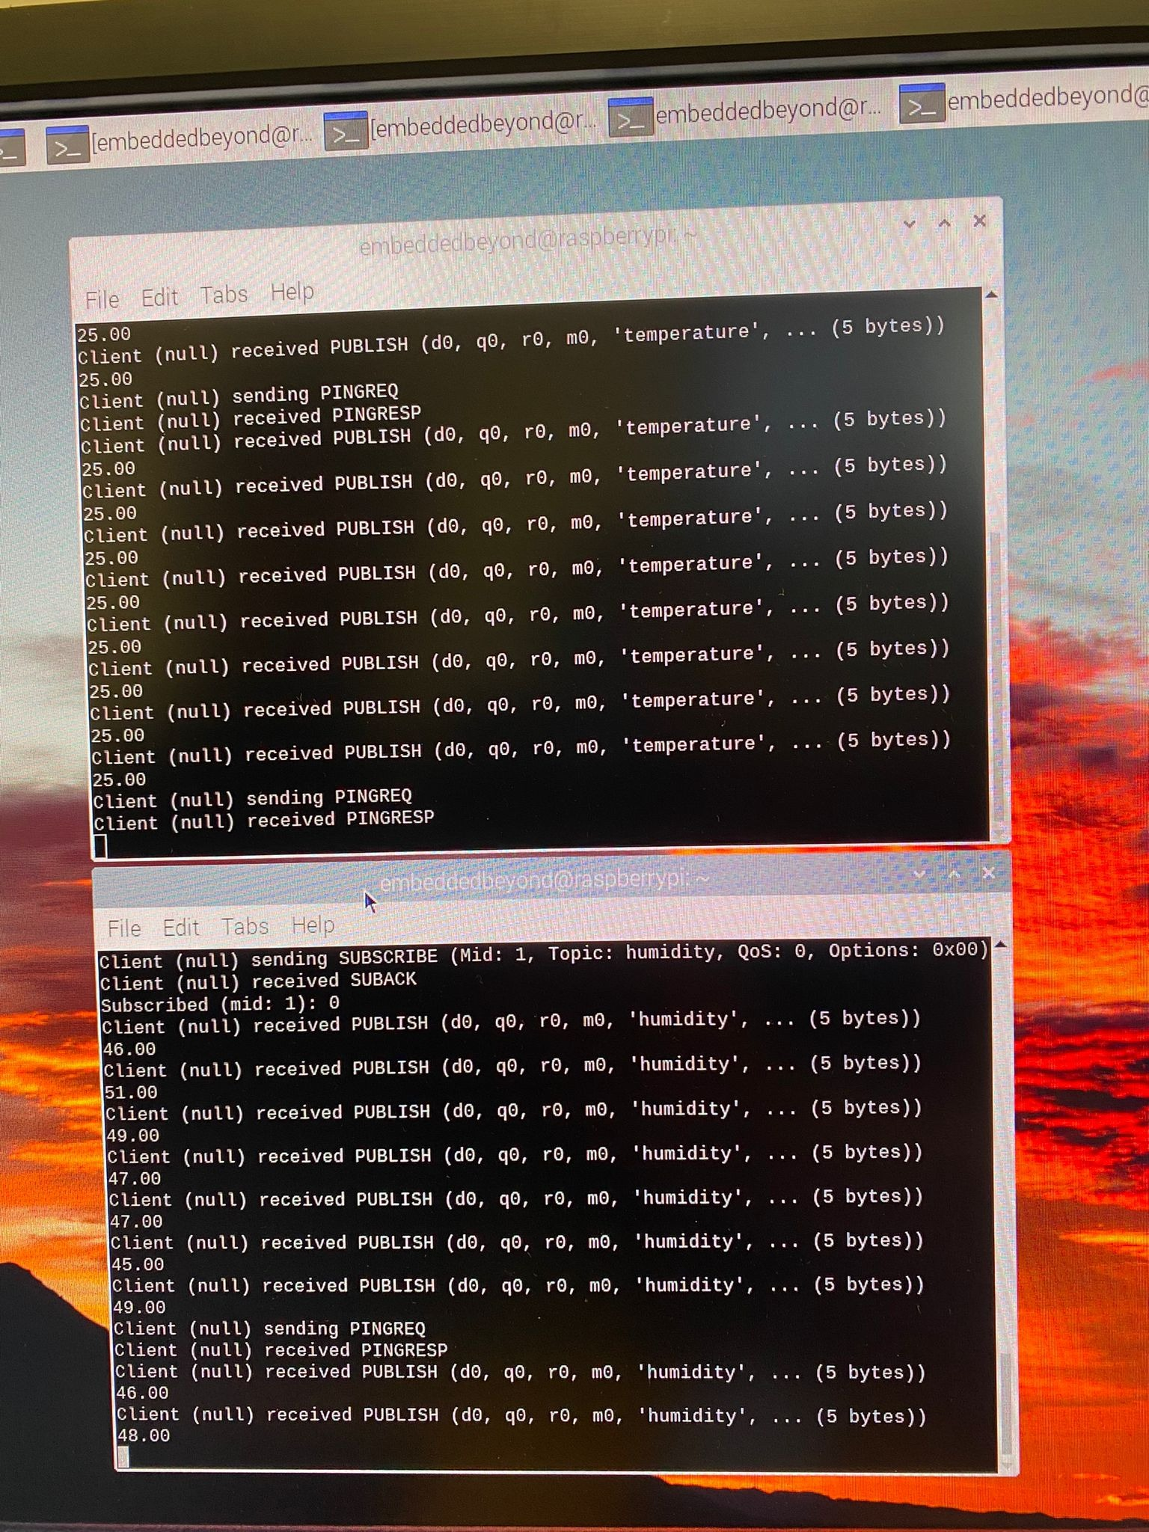
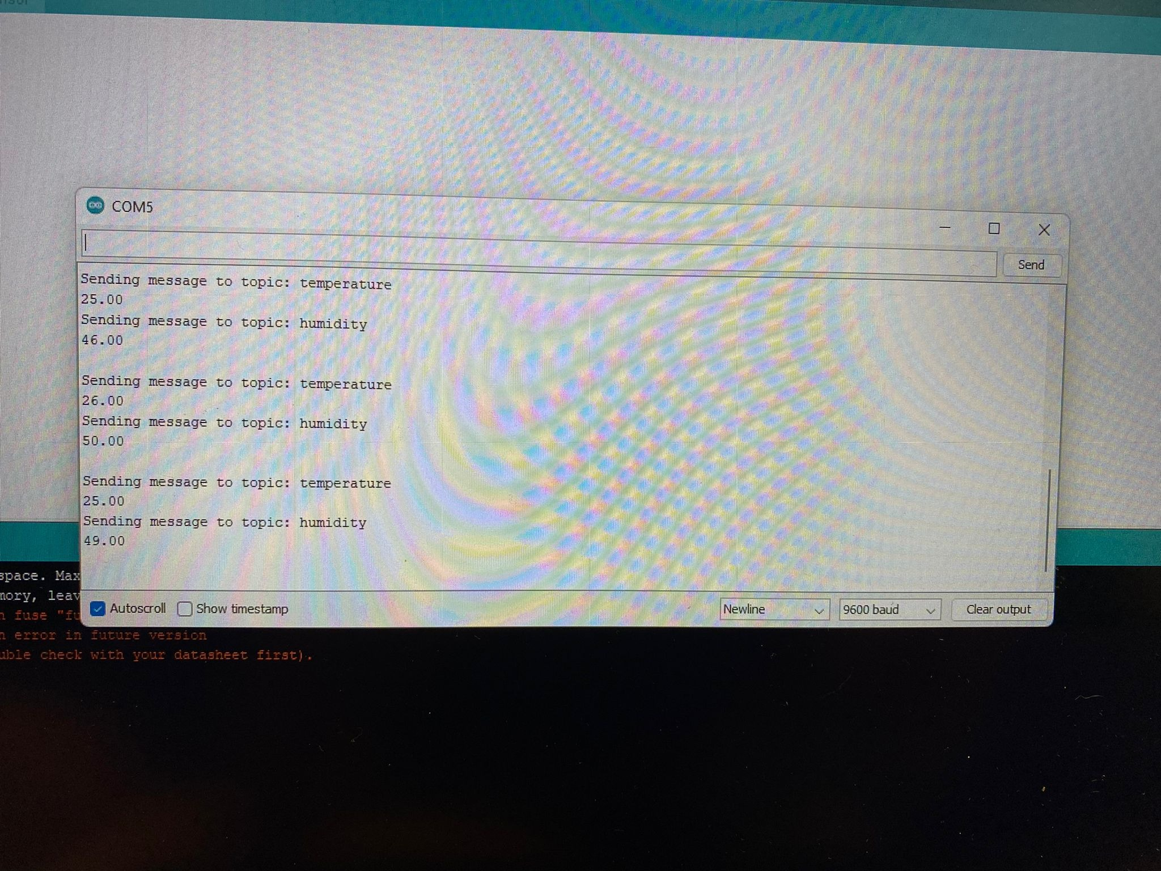
Results
Fig. 6 results
Fig. 7 results raspberry pi subscriber

Slide 19
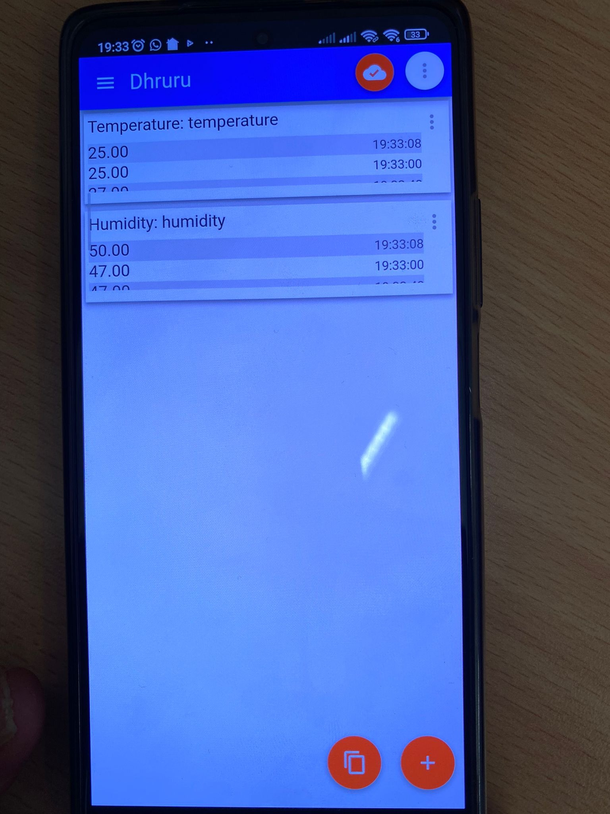
Results
Fig. 8 results android app

Slide 20
Conclusion
We encountered several problems
Smart pot will assist our users
Achieved accurate results

Slide 21
Thankyou for listening!

